Slide 1
Design and Analysis of Automatic Multi Bobbin Wire Winder
Author Name:
Prasad Hiray (UG Student, Mechanical Dept- VIIT, Pune)
Shreerang Karambelkar (UG Student, Mechanical Dept- VIIT, Pune)
Rutvik Khaire (UG Student, Mechanical Dept- VIIT, Pune)
Kunal Kulkarni (UG Student, Mechanical Dept- VIIT, Pune)
Guide Name:
Avinash Somatkar (Assistant Professor, Mechanical Dept- VIIT, Pune)

Slide 2
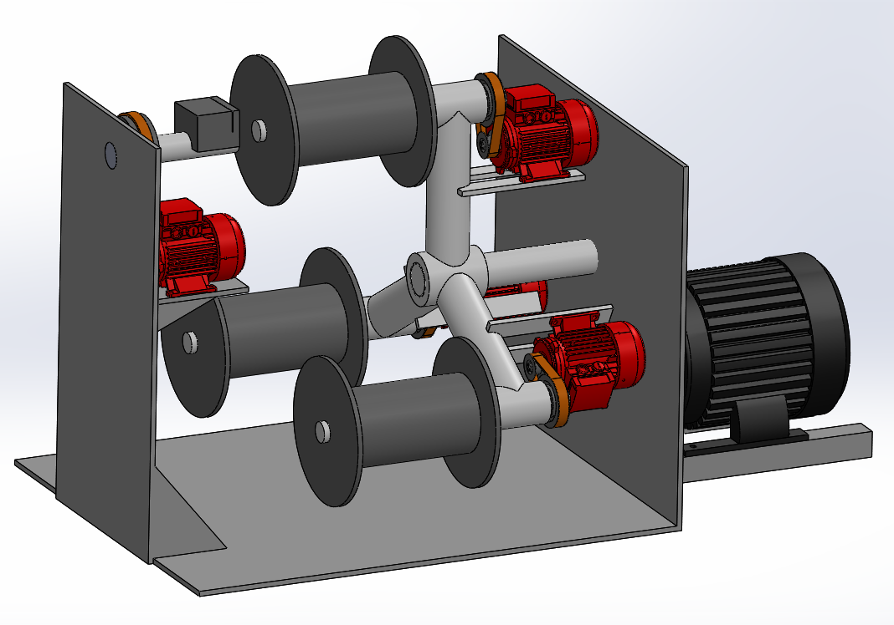
Outline
Introduction
Objectives
Literature Review
Methodology
Design
Machine Specifications
Analysis
Conclusion
References

Slide 3
Introduction
Winding machines have been being used in industry throughout the previous two centuries.
The current wire drawing machines ordinarily work utilizing a solitary winder and one bobbin to be filled and hence, halting the production line to change bobbins is essential.
To improve cost and advantage computation and increment in the speed of Production, we are presenting Automatic Multi Bobbin Winder.
This winding machine has three bobbins stacked which can be taken out from the twisting in the wake of filling without interfering with the production line.

Slide 4
Objectives
Develop Automatic Multi Bobbin winder.
Supplanting bobbin, clamping and entanglement of wire to be done automatically.
Minimum human involvement with maximum 1 person operating the machine.
Save Time for changing of Bobbins.
We have considered :
Wire stripping and entanglement mechanism work in right order.
One Bobbin to filled at a time.
Only final winding process in wire drawing to be done.

Slide 5
Literature Review
Every wire drawing machine needs winder to wound wire around bobbins/Spindles.
Single bobbin supplanted on winder.
Clamping and entanglement of wire on Bobbin was done manually.
Time required for changing bobbin and feeding wire is about 5 minutes on most of the current machines.
Very little or no automation in winding procedure.
Different style multi bobbin winders are available but are having complex structure.
Small scale Industries cannot afford highly expensive machines.

Slide 6
Methodology
Production Line analysis
Disadvantages of single spindle machines
Available Solutions
Design & Development of Multi Bobbin Winder

Slide 7
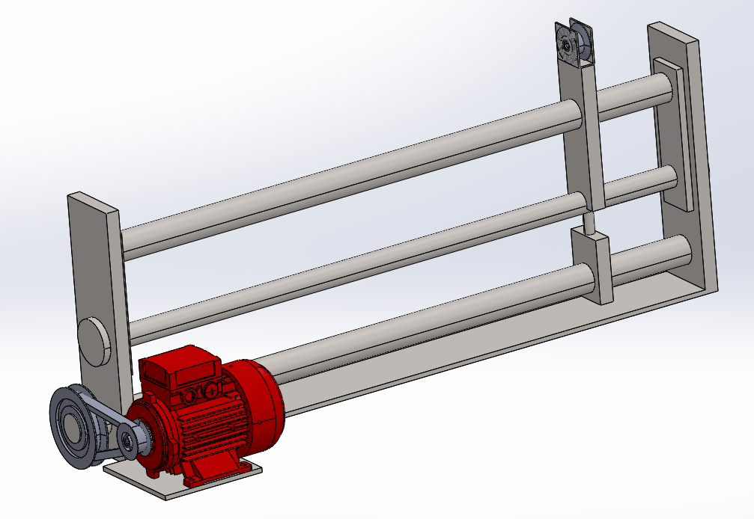
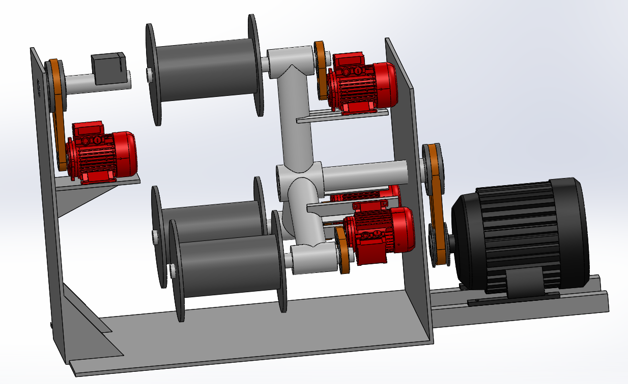
Design
Winding Traveller
Multi Bobbin Winder

Slide 8
Machine Specifications
Horizontal Tripod style winder:
Bobbin capacity- 40 kg wire
Wires preferred- All metals
Motor Specs:
1 Hp Induction motor for Bobbin’s
3 Hp Induction motor for Tripod frame with 3 Bobbins.
Electrical Panel to operate machine
Traveller Specs: 1 Hp Synchronous motor with Pulley on screw for thorough winding
Entanglement Mechanism:
1 Hp motor

Slide 9
Analysis
Equivalent Stress
Total Deformation-
2.4906 MPa – max stress
0.038 mm Max Deformation

Slide 10
Conclusion
Automatic clamping and entanglement of wire is possible.
Simultaneously supplanting bobbins is done.
Changing bobbin after filling does not interfere production process.
Production rate will upsurge.
Improve cost-benefit ratio.
Successfully Automate the production line for wire drawing process using Automatic multiple bobbin winder.

Slide 11
References
Vaskar, P., Zambare, S., Waje, S., & Vhora, R. (2018). DESIGN AND DEVELOPMENT OF AUTOMATIC COIL WINDING MACHINE. https://www.irjet.net/archives/V5/i6/IRJET-V5I6258.pdf .
Devarajapandian, R., Shanmuganantham, M., & Kannadhasan, S. Performance of Winding Machine in Transmitter and Receiver for PLC Applications. http://www.ijareeie.com/upload/2021/april/45_PAPER%202_NC.pdf
https://learnmech.com/design-automated-coil-winding-machine
https://www.youtube.com/watch?v=yR1dVawvA14
https://www.youtube.com/watch?v=x-cihbjY49I
https://www.youtube.com/watch?v=Kv1xnqfPLQA
https://www.youtube.com/watch?v=pD_5QcF72j0

Slide 12
THANK YOU

